Slide 1
Geodatabase Basics
Querying Data
Table Joins
Notes:
Before Start:
- Handout – syllabus
Turn up volume for scream effect
Open blank arcmap

Slide 2
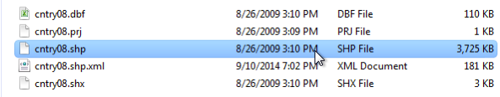
The Shapefile
We have been currently using shapefiles in class
These are spatial datasets which predate the geodatabse, but are still widely used
They only can store vector data
Cannot store curves
Made up of a lot of different pieces
2 Gigabyte Size Limit

Slide 3
Geodatabases
Geodatabases allow for data to be stored in single database
Can store tables, shapefiles, rasters, and annotation
Allows for the storing of true curves
In a file geodatabase there is a 2 terabyte limit per feature class
Enterprise geodatabases have no limits
Must be created in ArcGIS

Slide 4
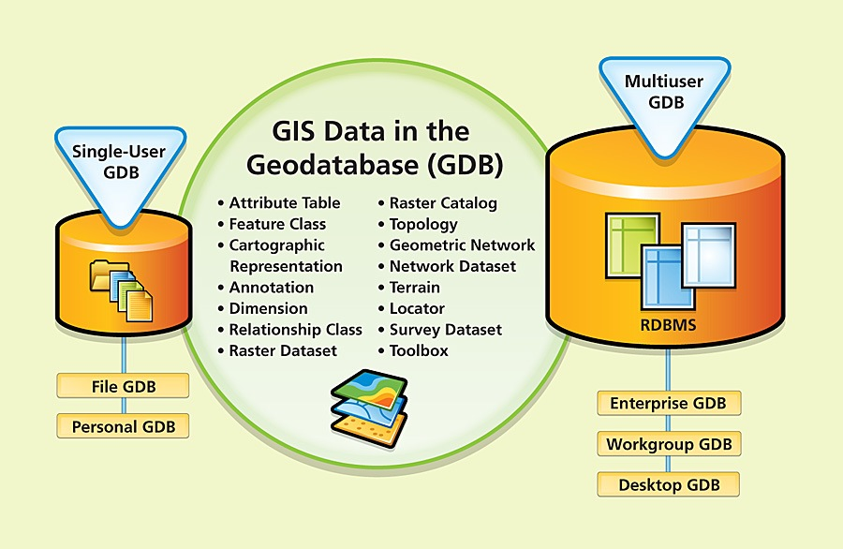
What is a Geodatabase?
http://www.esri.com/news/arcnews/winter0809articles/winter0809gifs/p1p2-lg.jpg

Slide 5
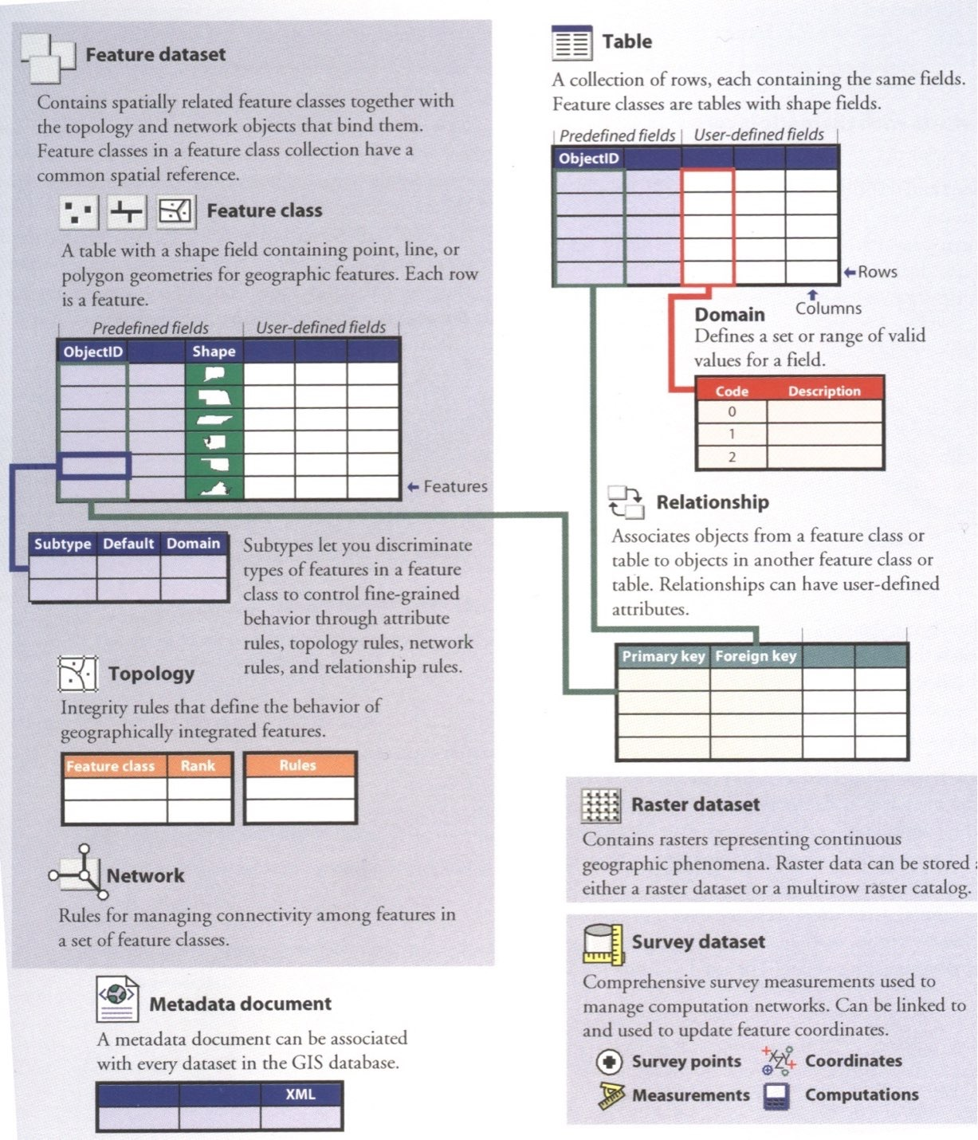
Overview of Geodatabase Architecture
From Arctur(2004)

Slide 6

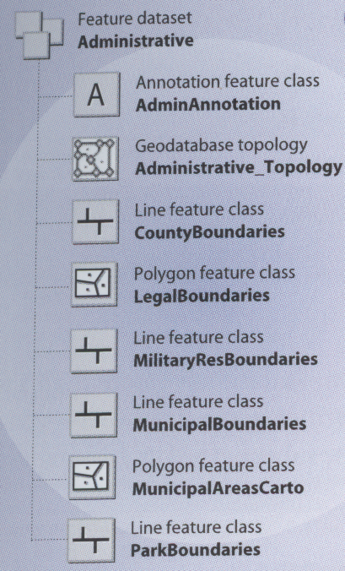
Feature Dataset
Contains spatially related features
A logical organization container
Notes:
Calgary – Address FDS, Administrative, Census 200 etc

Slide 7
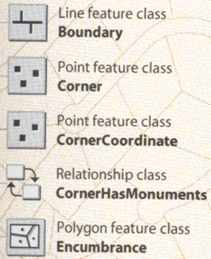
Feature Class
The primary storage for spatial data
Standalone and part of feature dataset
Notes:
Many feature classes in Calgary

Slide 8
Querying and Selecting Data
Query – ask a question
Many ways to query data in ArcMap
Identify tool
Using a graphic
Select by Location
Select by Attribute
Find tool

Slide 9
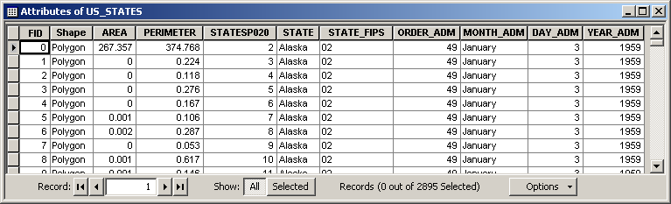
Query Basics
SELECT * FROM US_STATES WHERE STATE = ‘Alaska’
“where the value of the STATE column is equal to the value ‘Alaska’”
“give me everything from the table US_STATES”

Slide 10
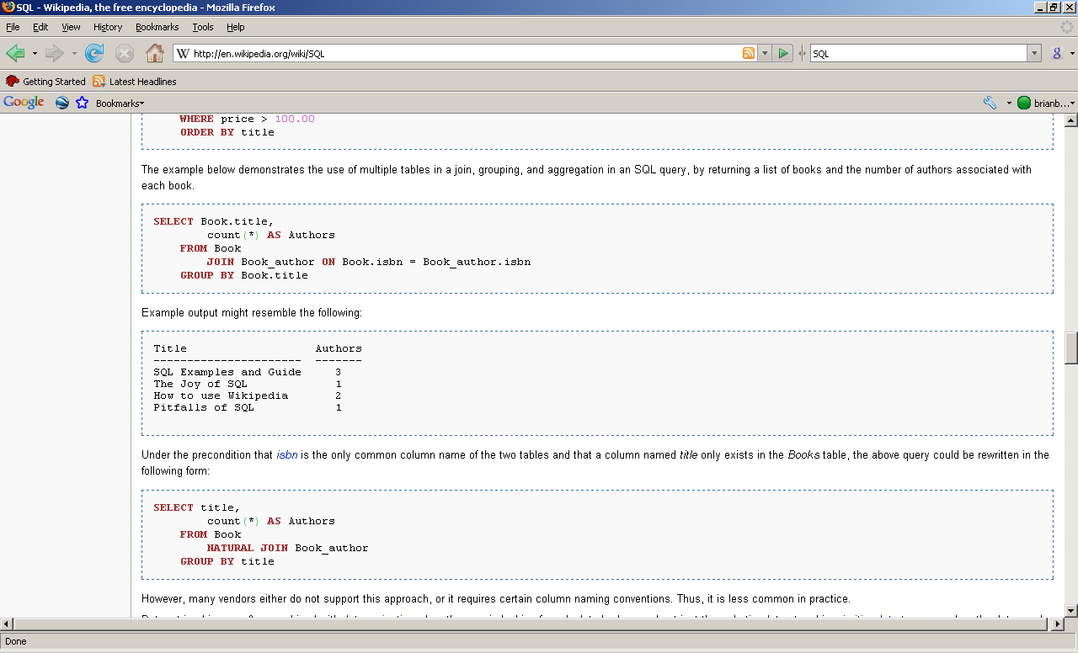

SQL
Structured Query Language
Used Implicitly and Explicitly in ArcGIS
Combine tables, fields, operators, much more..

Slide 11
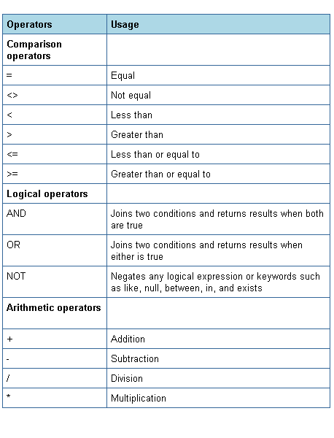
SQL WHERE Operators
http://iuiedocs.oes.indiana.edu/images/operators.png

Slide 12
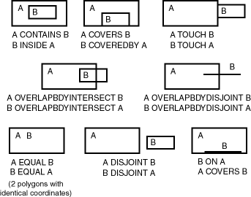
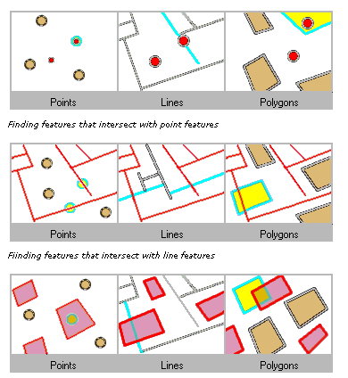
Spatial Operators for Querying
http://www.stanford.edu/dept/itss/docs/oracle/10g/appdev.101/b10826/top_rel.gif
Intersect Example
Non-exhaustive list
See ArcGIS Help Topic “Select By Location dialog” for more info
Used as a “spatial” WHERE clause

Slide 13
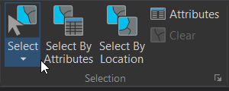
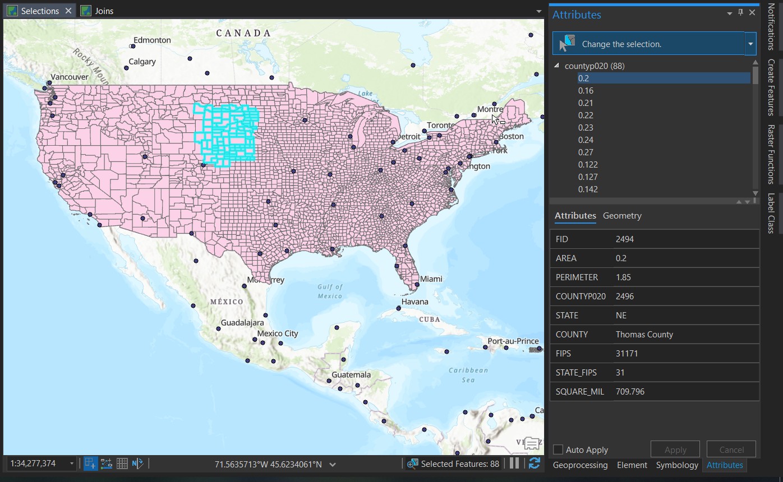
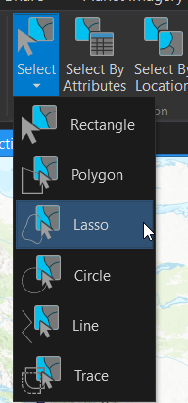
Interactive Selection Tool

Slide 14
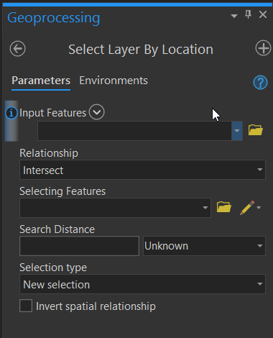
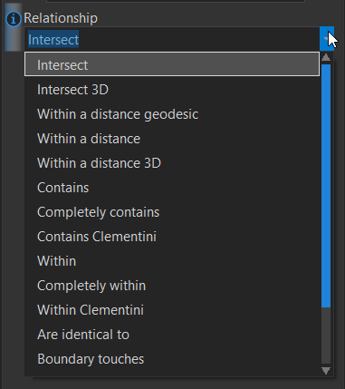
Select by Location
Uses Spatial Operators

Slide 15
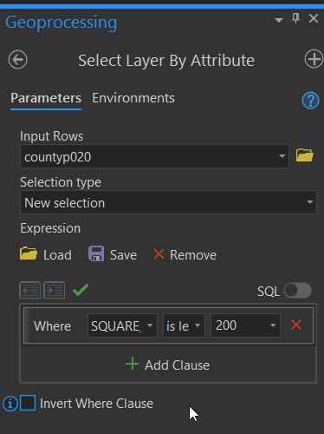
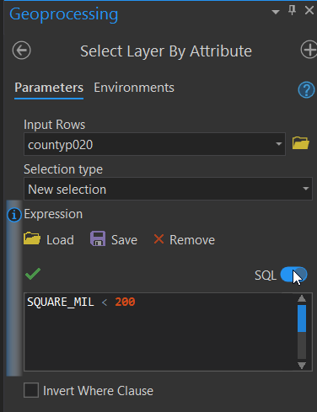
Select by Attribute
Build the WHERE part of query
Full query being built

Slide 16
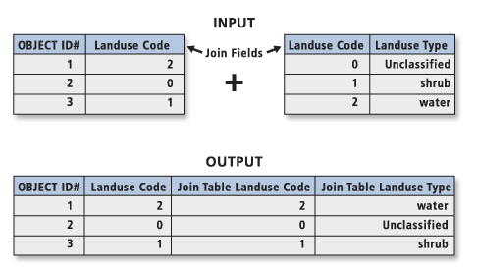
Table Join
“Appending the fields of one table to those of another through an attribute or field common to both tables. A join is usually used to attach more attributes to the attribute table of a geographic layer.”
Notes:
When you join two tables, you append the attributes from one onto the other based on a field common to both.

Slide 17
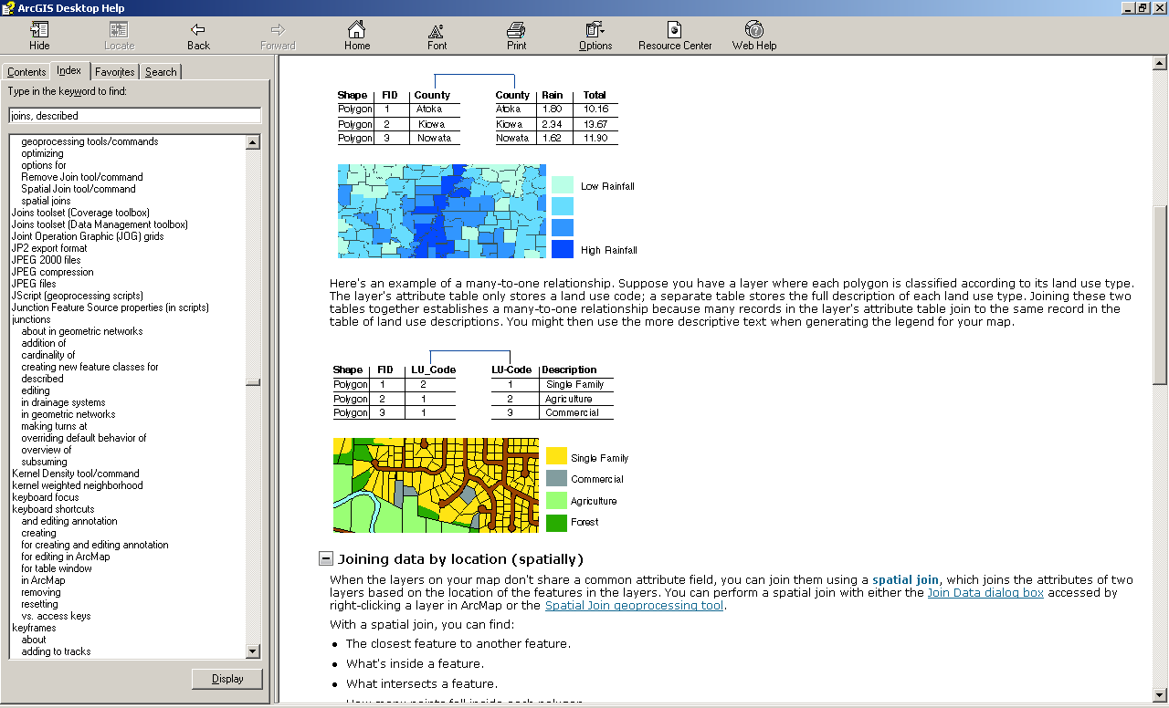
Join on number
Join on string (text)

Slide 18
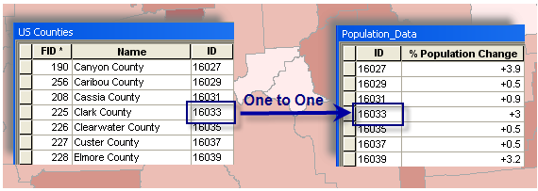
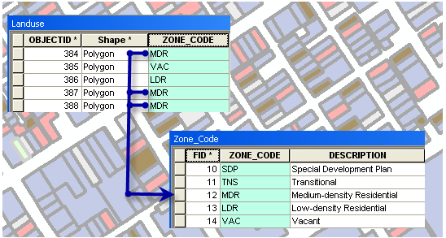
One to Many
Notes:
Caution:
If you try to create a join on a 1:M relationship, only the first match will be joined in the resulting joined layer.

Slide 19
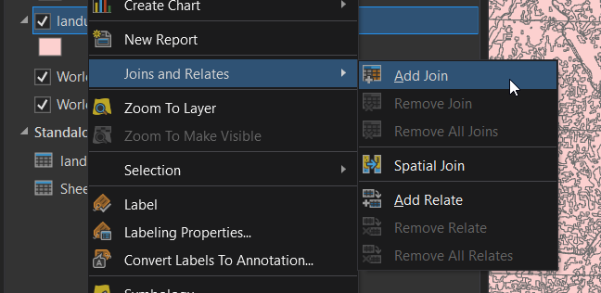
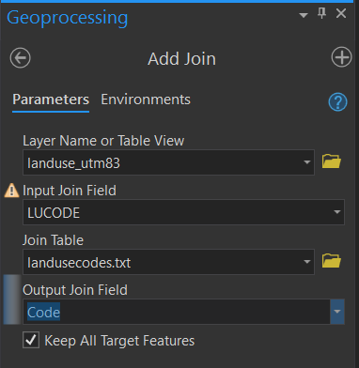

Slide 20
Hands-on – Querying and Table Joins
Please do not do these steps until told to do so by the instructor (i.e. no skipping ahead)
Download and unzip locally the file Week4_hands_on_materials.zip from myCourses under Content Week 4
Look at a File Geodatabase
Select by location (counties/cities) (All cities within NY counties)
Table join (observe different data types)

Slide 21
Cartography
Basic map making

Slide 22
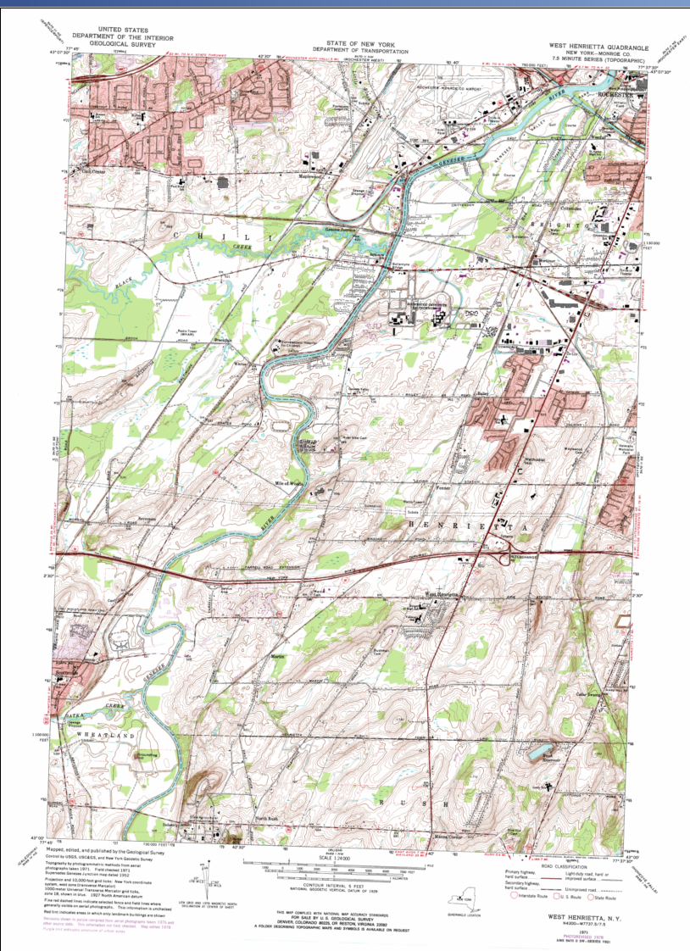
Review - Reference Map
Numerous features
No specific information being shown
Good for a base map to show other information

Slide 23
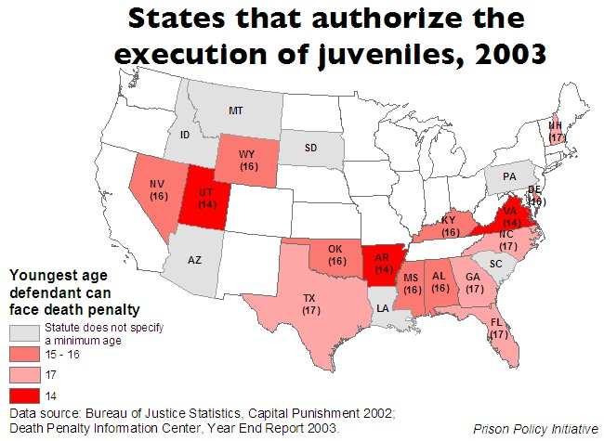
Review - Thematic Map
Distributions of a single attribute
Relationships among several attributes
http://www.prisonpolicy.org/images/juvenile_dp_laws_us.jpg

Slide 24
Basics of Map Design
Graphic Elements
Figure/Ground
Visual Variables

Slide 25
Graphic Elements
First St.
Point
Line
Area
Park
Home St.
River
My house

Slide 26

Figure/Ground
Main figure on the map vs. background
Ambiguous FG – vase or faces?

Slide 27
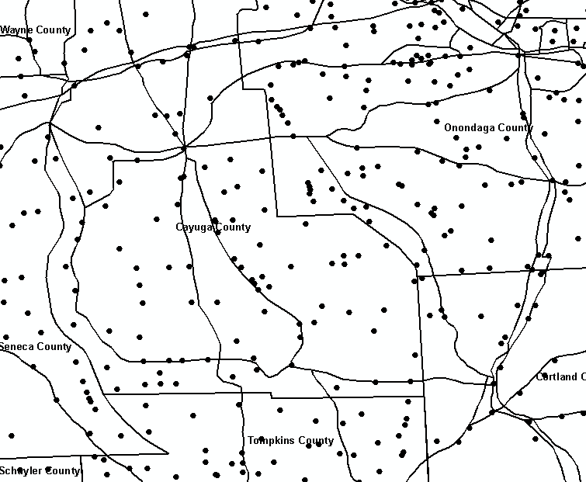
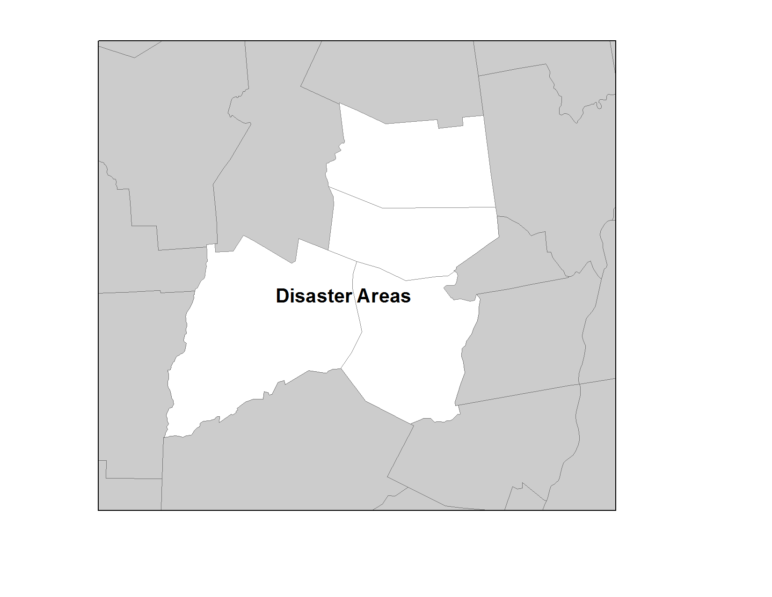
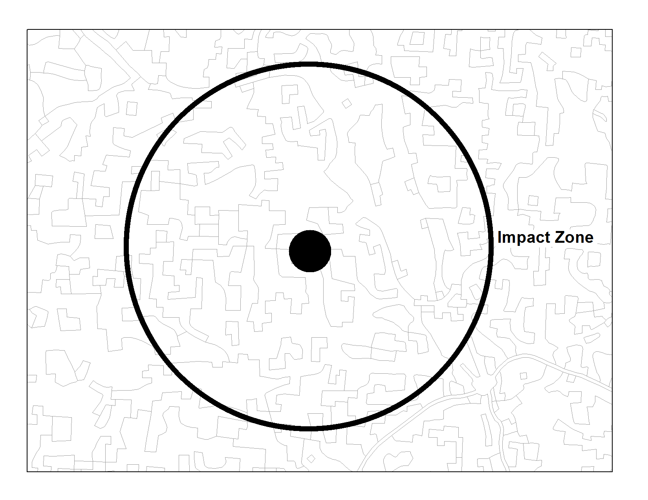
Figure/Ground
Dark – Ground
Light - Figure
Ambiguous FG
Dark – Figures
Light - Ground
© 2013 B. Tomaszewski

Slide 28
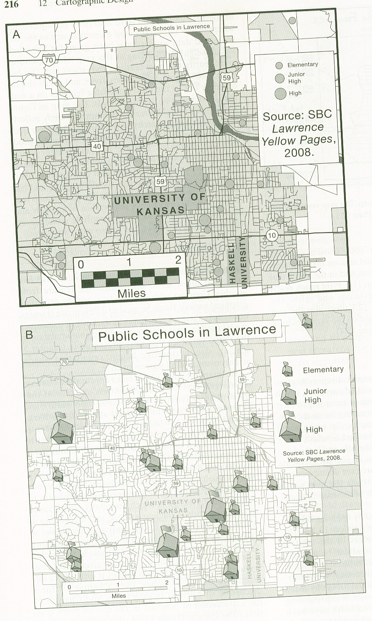
Visual Hierarchy
Slocum et. al. 2005
Notes:
Graphical repreentation of intellectual hierarchy

Slide 29
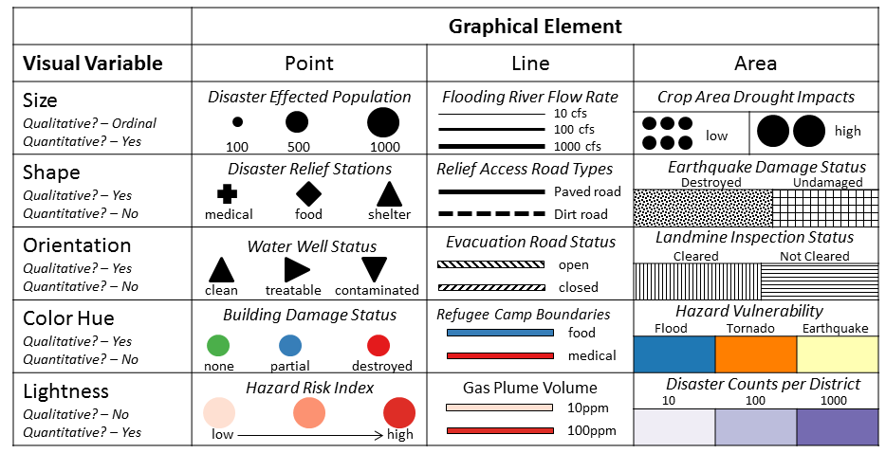
Visual Variables
© 2013 B. Tomaszewski

Slide 30
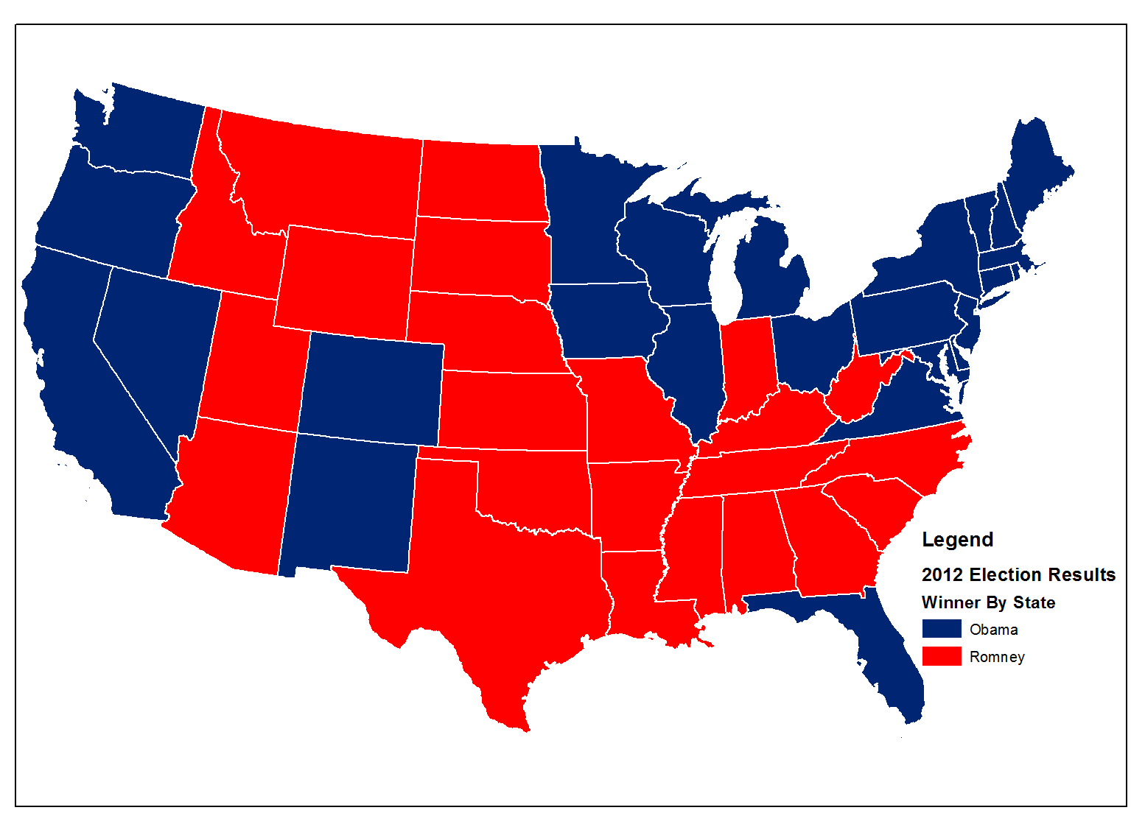
Color Hue - Qualitative Distinction
© 2013 B. Tomaszewski

Slide 31
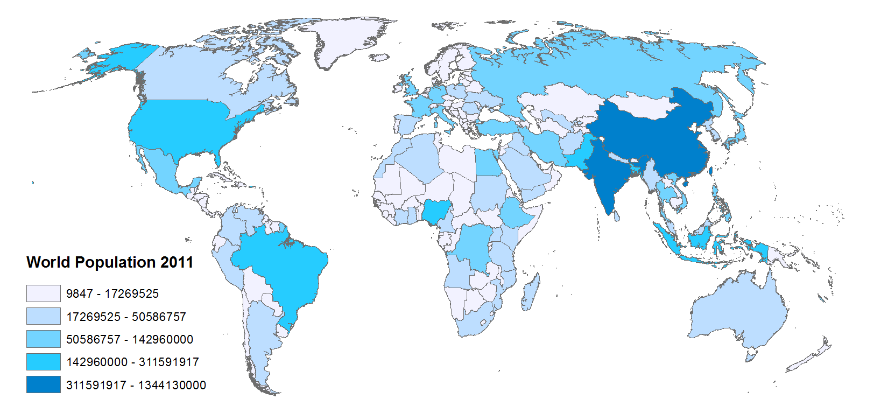
Lightness - Quantitative Distinction
© 2013 B. Tomaszewski

Slide 32
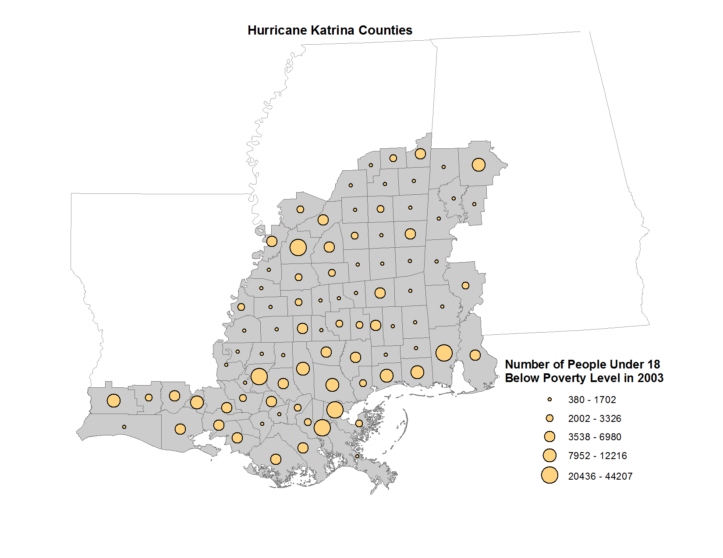
Size - Quantitative Distinction
© 2013 B. Tomaszewski

Slide 33
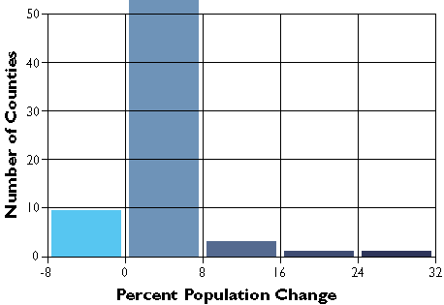
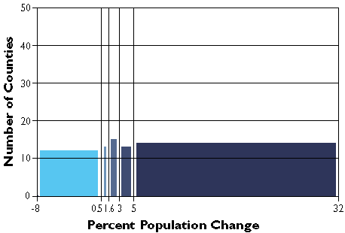
Thematic Mapping
Equal Interval
Equal range of values in each class
Each class will likely contain a different number of features
Divide the total range of values by the number of classes (in our case, 5)
this gives you the value range of each class
Quantile (percentile)
Equal number of features in each class

Slide 34
Natural Breaks (Jenks)

Slide 35
Natural Breaks (Jenks)

Slide 36
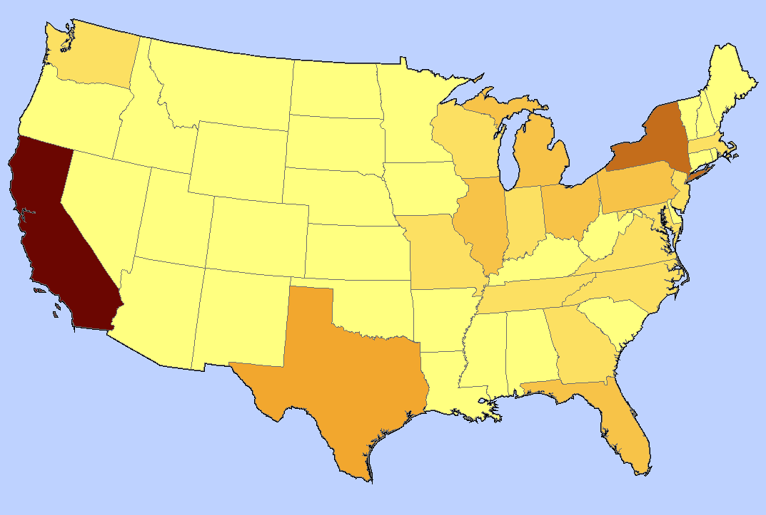
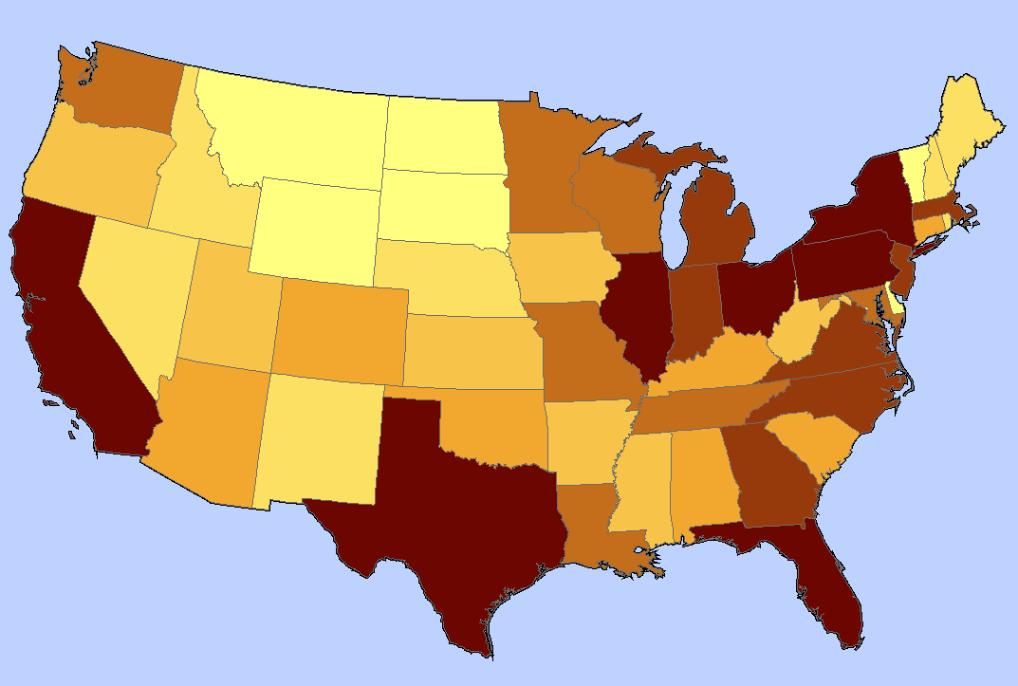
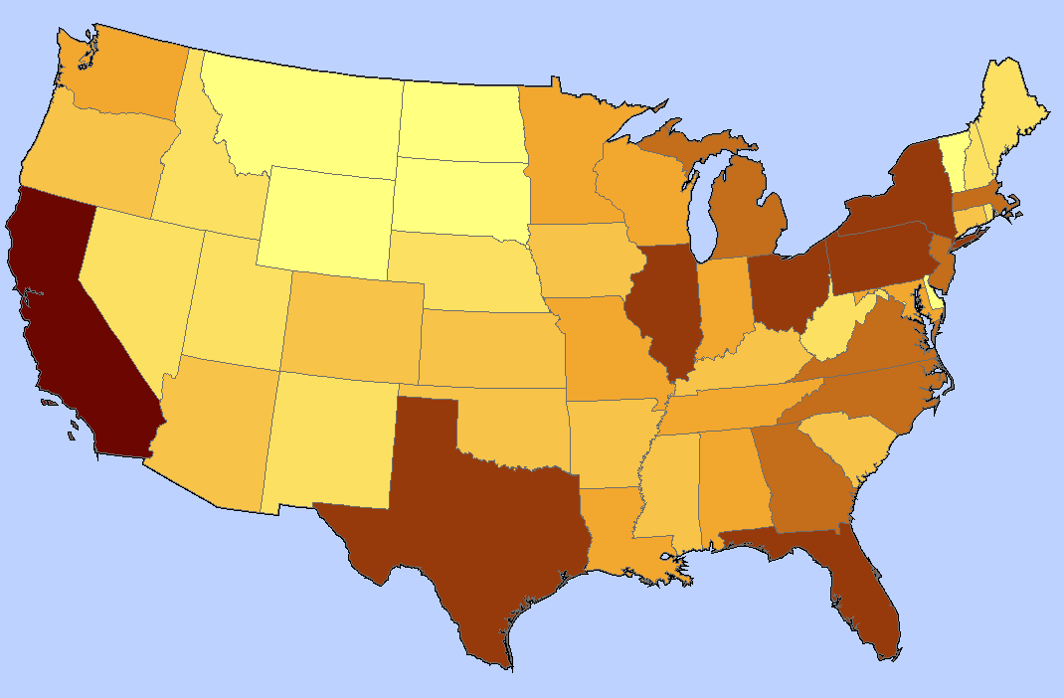
Comparison of equal interval, quantile and Jenks
Equal interval
Quantile
Jenks
Notes:
When is it useful to choose the method of equal class intervals?
It is appropriate to use equal class intervals when the data distribution has a rectangular shape in the histogram. This, however, occurs very rarely in the context of geographic phenomena. Moreover, it is useful to use this method when your classification steps are nearly equal in size. The major disadvantage of this method is that class limits fail to reveal the distribution of the data along the number line. There may be classes that remain blank, which of course is not particularly meaningful on a map.
Quantiles Classification
An advantage of quantiles is that classes are easy to compute, and that each class is approximately equally represented on the final map. Moreover, quantiles are very useful for ordinal data, since the class assignment of quantiles is based on ranked data. The main disadvantage of this classification method are the gaps that may occur between the observations. These gaps sometimes lead to an over-weighting of some single detached observations at the edge of the number line.
The Natural Breaks Classification
Applying the classification method of "natural breaks”, we consider visually logical and subjective aspects to grouping our data set. One important purpose of natural breaks is to minimise value differences between data within the same class. Another purpose is to emphasize the differences between the created classes.
A disadvantage of this method is that class limits may vary from one map-maker to another due to the author's subjective class definition (Slocum 1999). The Jenks-Caspall Alorithm formalizes this procedure and is often used in GIS software.
http://www.gitta.info/Statistics/en/html/StandClass_learningObject2.html

Slide 37
Picking Colors
Lots of things to take into consideration with your map color schemes
Main one is the audience and what you are trying to tell
ArcGIS Symbology Templates are a good place to start
For more advanced ideas there is the colorbrewer2.org web site
Gives you colors and ramps to fit a variety of different use cases
Can pick colorblind safe, print friendly, or photocopy safe schemes

Slide 38
Working With Layouts
What maps do?
maps convey geographic information
highlight geographic relationships
present analysis results
guide people to a location

Slide 39
Working With Layouts
Things to consider when making a map
how and where it will be presented
who is the intended audience
reality and the need to generalize
scale and technical limits

Slide 40
Gretchen Peterson’s Map Evaluation Checklist

Slide 41
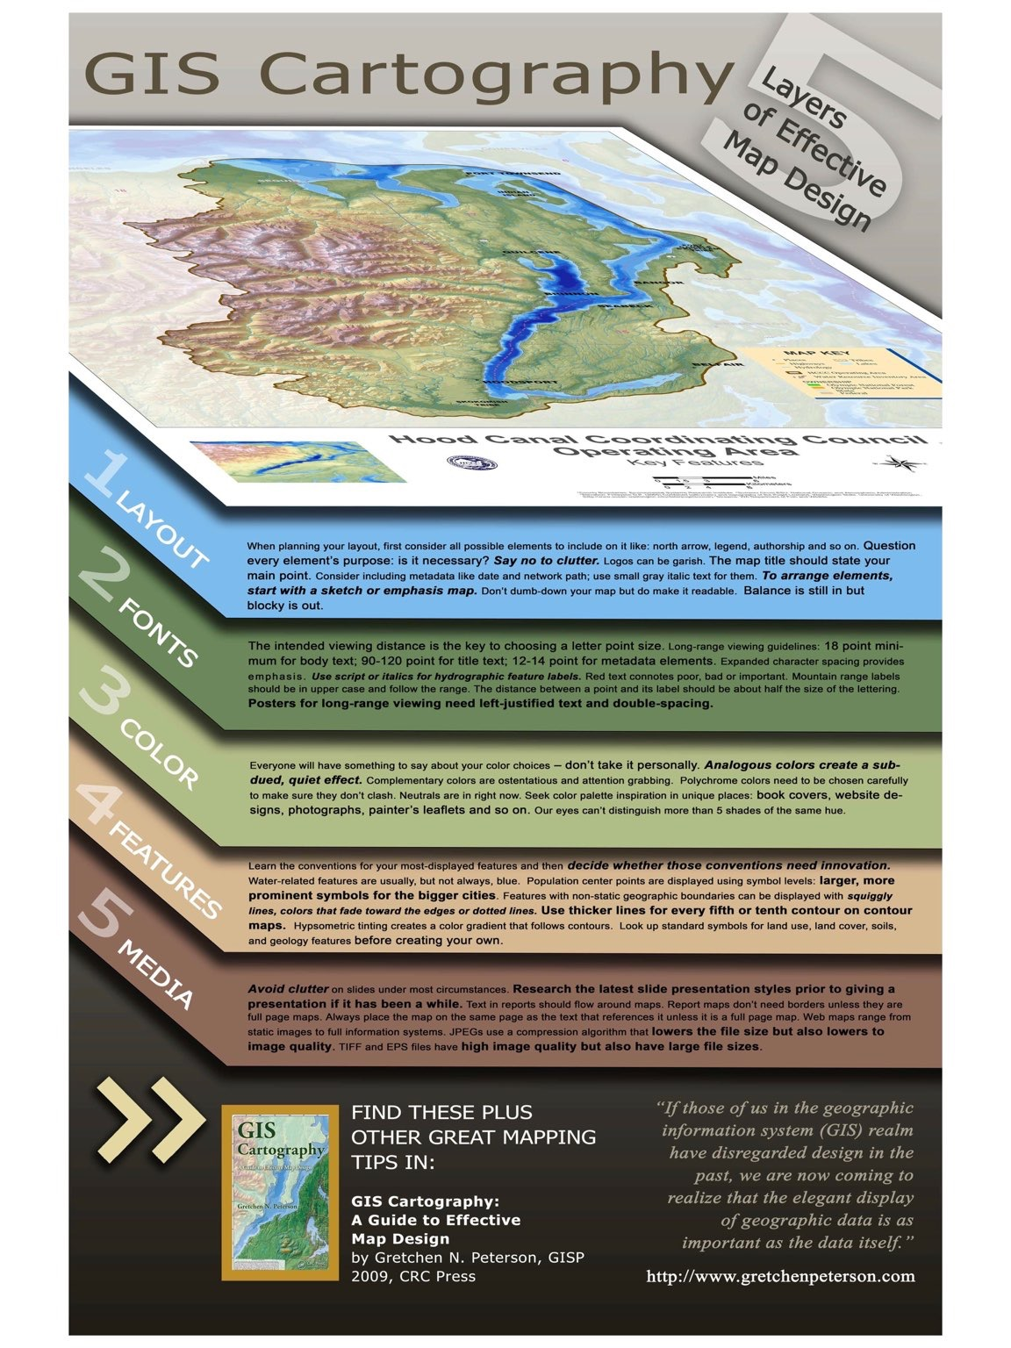

Slide 42
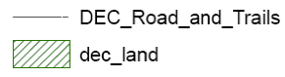
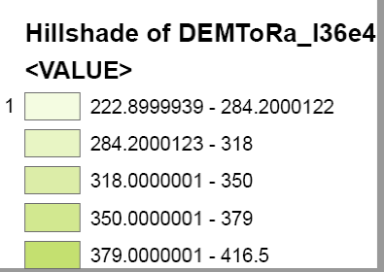
Things to Watch For
remove_underscores_from_titles_they_look_funny
round numbers so there aren't as many decimal places

Slide 43
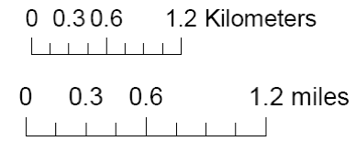
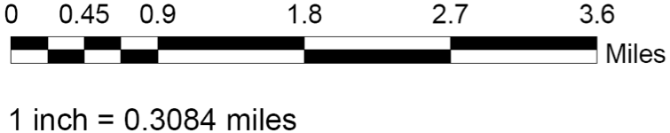
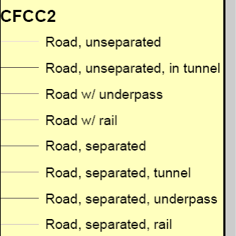
Things to Watch For
use even rounded numbers for scale bar increments. for example, end the graphic scale at 5 miles or 2.5 miles
use different sizes as well as colors to discern the various feature types (roads in this example), especially when you showing many classes, in this example, they are hard to understand. Also, make sure labels are intuitive – in this example, what does "road, unseparated" really mean? better classification would be "interstates, county roads etc
make sure your legend titles are meaningful and will be understood by someone other than you

Slide 44
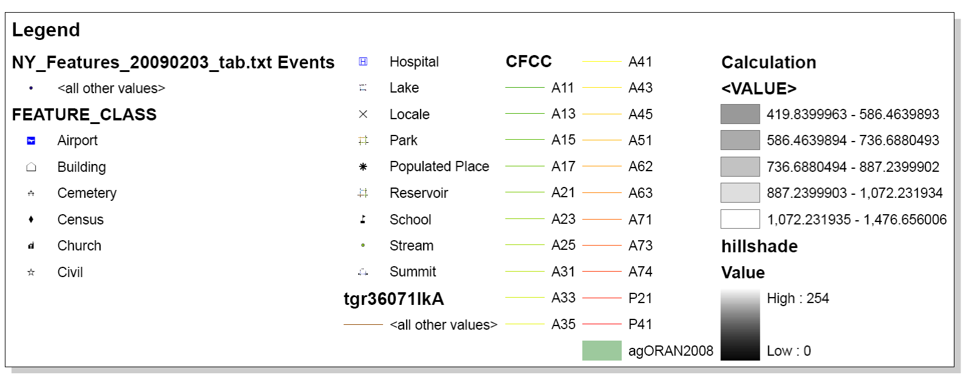
Things to Watch For
????
make sure all legend items are relevant
????
Is this needed?

Slide 45
Lab - GIS and Basic Map Making Due Date: September 30th 11:59 PM
Reminders:
Data is Lab4Data.zip
Next Class Readings

Slide 46
Readings
Brewer_Designing_Better_Maps_Ch_1
GIS cartography poster by Gretchen Peterson
Map Evaluation Checklist
MacEachren_1995_c1
GPS-Posterweb
Difference between recreational and professional grade gps receivers
why-postprocess

